Slide 1
Introduction to Probability and Statistics
4CM521
Notation and Definitions

Slide 2
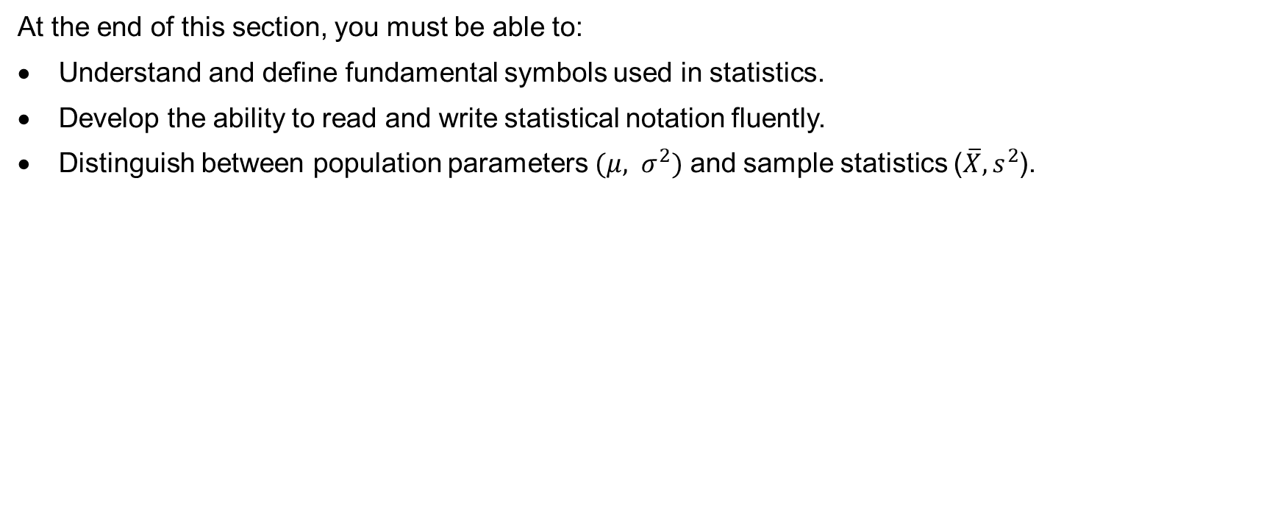
Learning outcomes
At the end of this section, you must be able to:
Understand and define fundamental symbols used in statistics.
Develop the ability to read and write statistical notation fluently.
Distinguish between population parameters $(μ, σ^{2})$ and sample statistics ($\overline{X}, s^{2}$).

Slide 3
Introduction
Statistics, a powerful discipline within the realm of mathematics, plays a pivotal role in transforming raw data into meaningful insights and informed decisions.
It provides a systematic framework for collecting, organising, analysing, interpreting, presenting, and drawing conclusions from data.
In essence, statistics is the science of learning from data.

Slide 4
Population definition
Population¹: A population is any entire collection of people, animals, plants or things from which we may collect data. It is the entire group we are interested in, which we wish to describe or draw conclusions about.
1. http://www.stats.gla.ac.uk/steps/glossary/basic_definitions.html

Slide 5
Example 2.1
Suppose an election is happening soon. We want to do a study looking at who people in the United Kingdom will vote. What is the population for this study?
Solution
All people who have registered to vote by the deadline.
1. http://www.stats.gla.ac.uk/steps/glossary/basic_definitions.html

Slide 6
Sample definition
Sample²: In practice, it is almost impossible to study the entire population. Thus, we need a smaller group which represents the population. We call this group a sample and define it as a group of units selected from the population. For each population there are many possible samples.
A sample is generally selected for study because the population is too large to study in its entirety. The sample should be representative of the population. This is often best achieved by random sampling.
It is important that the researcher/investigator has a complete and precise definition of the population before collecting the sample, including a description of the members to be included.
2. http://www.stats.gla.ac.uk/steps/glossary/basic_definitions.html

Slide 7
Example 2.2.
All registered voters in Nottingham can be considered as a sample from the population for the study described in Example 2.1. Is this a good sample?
Solution
Not really. Nottingham doesn’t represent the UK as a whole. (Nobody registered to vote in Nottingham will be voting SNP or Plaid Cymru!)

Slide 8
Example 2.3.
An investigator is interested in the crime rate in different areas of Nottingham. To identify areas for their study, they use Nottingham postcodes (see http://en.wikipedia.org/wiki/NG_postcode_area). They decide to make their conclusion based on the 5 selected postcodes from all NG postcodes sorted alphabetically. Therefore,
Population of interest – Every postcode in the list
Sample – NG1, NG2 NG3, NG4 and NG5
Criticisms of the study – Doesn’t represent the entire area. NG1-5 postcodes are all close to Nottingham city centre but the NG postcode region includes very different areas.

Slide 9
Parameters³ and Statistics⁴ definitions
A parameter is usually an unknown value (and which therefore must be estimated), used to represent a certain population characteristic. For example, the population mean is a parameter that is often used to indicate the average value of a quantity.
A statistic is a quantity that is calculated from a sample of data. It is used to give information about unknown parameters in the corresponding population. For example, the average of the data in a sample is used to give information about the overall average in the population from which that sample was drawn.
3. http://www.stats.gla.ac.uk/steps/glossary/basic_definitions.html#param
4. http://www.stats.gla.ac.uk/steps/glossary/basic_definitions.html#stat

Slide 10
Example 2.4.
Suppose we want to know what percentage of people in the UK are over 180cm tall. We have a sample of 1000 people from the UK available.
Parameter of interest - The percentage of people in the population over 180cm tall in the UK.
Statistic of interest - The percentage of people over 180cm in the sample is a statistic that we could use to estimate our parameter of interest.

Slide 11
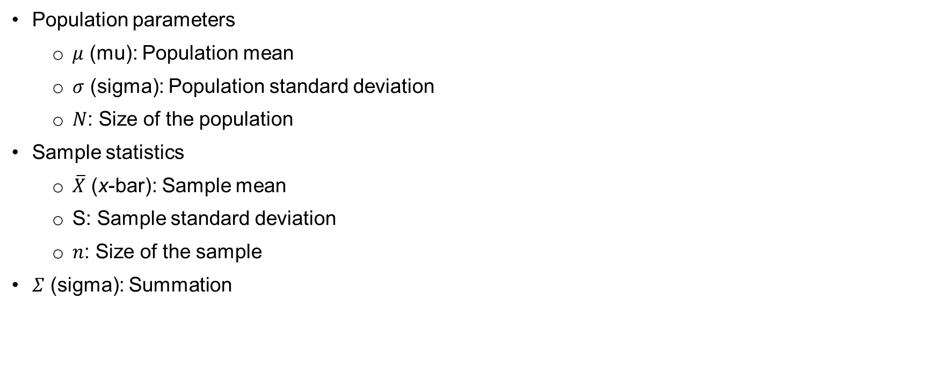
Population and sample notation
Population parameters
  $μ$ (mu): Population mean
  $σ$ (sigma): Population standard deviation
  $N$: Size of the population
Sample statistics
  $\overline{X}$ (x-bar): Sample mean
  S: Sample standard deviation
  $n$: Size of the sample
$Σ$ (sigma): Summation

Slide 12
Taking a Sample
Clearly a sample with a reasonable size should be as representative of the population from which it is drawn as possible.
There are many, many examples in the newspapers and magazines of reports and conclusions based on unrepresentative and/or unreasonable small samples.
You have already seen such samples in Examples 2.2 and 2.3.

Slide 13
Example 2.5.
Suppose we want to do a study on what people’s favourite sport is in the UK. Person A stands outside a rugby stadium on match day and ask 10 people to name their favourite sport. Person B stands in Nottingham City Centre and asks 1000 people to name their favourite sport. Whose study is better? Is either perfect?
Solution
Person B’s study is clearly better as they have a larger sample from people that are more representative of the population as a whole. It’s still not perfect though. People in Nottingham alone are probably not representative of the entire UK.

Slide 14
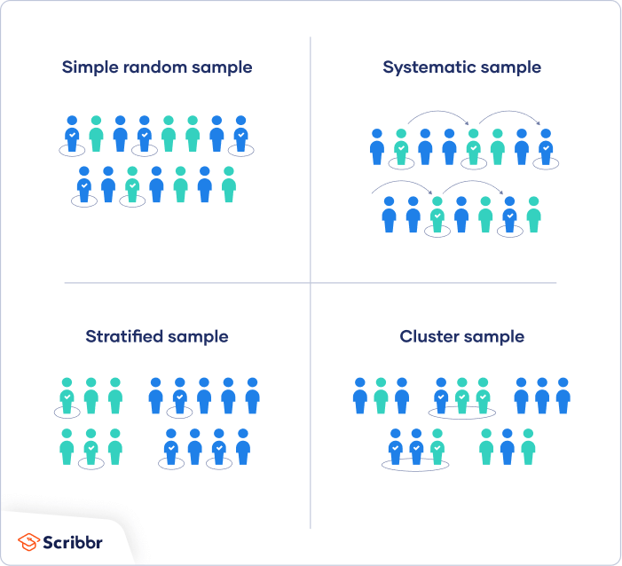
Types of sampling
These examples highlight how important it is to select the sample to give an accurate reflection of the characteristics of the whole population.
There are possible ways of choosing a sample from a given population.
  simple random sampling
  cluster sampling
  systematic sampling
  quota sampling

Slide 15
Example 2.6
Do it in R:
#To sample 3 elements from a vector 1:10 without replacement:
x<- sample(1:10, 3)
x
## [1] 6 3 7
#To sample 3 elements from a vector 1:10 with replacement:
y<- sample(1:10, 3, replace = TRUE)
y
## [1] 4 8 7
#Random sample with weighted probabilities
probabilities <- c(0.1, 0.1, 0.2, 0.2, 0.05, 0.05, 0.1, 0.05, 0.05, 0.1)
z<- sample(1:10, 3, prob = probabilities)
z
## [1] 4 8 3

Slide 16
Types of Data
The data can be classified into different categories.
We will see that different analytical methods are appropriate for different types of data.
The data can be categorised into two main types:
  Qualitative data, also known as categorical data, these types of data are non-numerical and can be either nominal or ordinal (more on this in a moment).
  Quantitative data, these types of data are numerical and can be either discrete or continuous (more on this in a moment).

Slide 17
Nominal Data
Nominal data consist of simple labels
  male/female/non-binary
  employed/unemployed
  geographical area such as American/Afghan/Northern Indian/Oriental
They can take on numerical values (such as “0” indicating no and “1” indicating yes), but those numbers don’t have mathematical meaning.
Examples: Gender, nationality, university attended

Slide 18
Ordinal data
Ordinal data have a natural or inherent ordering
For example, the response to a question asking respondents to rate the service of the retailer from 1 to 5 where 1 is “poor” and 5 is “excellent” is an example where the categories are ordinal.
Data such as age or salary may also be ordinal if they have been categorised into groups for the purposes of data collection. (Under 16, 16-25, 26-40, 41-64, 65+)
Examples: Ratings out of 10, categorised ages, university grade

Slide 19
Discrete Data
Discrete data usually arises from counting something and consists of whole numbers.
The data can only take specific separate values such as 0, 1, 2 etc.
For example, the number of children under 18 in a family is discrete.
Examples: Shoe size, number of exams taken, goals scored
How many cats do the students in my class have?
Number of cats | Number of students
0 | 13
1 | 5
2 | 7
5 | 1

Slide 20
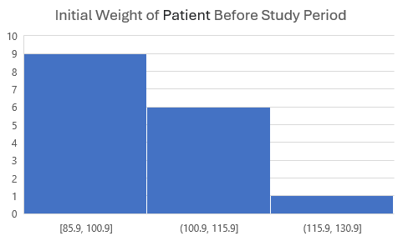
Continuous data
Continuous data can only be described using intervals on the real number line.
They usually arise from measuring something such as time, weight, height, or length.
Continuous data will always be rounded. The degree of accuracy used depends on the situation.
For example, someone’s height is a continuous variable. The respondents may report their height to the nearest whole number or to the nearest ½ whole number.
If continuous data are rounded, then they will look like discrete data. Thus, ask yourself if this is a measure that has been rounded. If it is then the data are continuous.
Examples: Height, weight, distance travelled

Slide 21
Quiz
https://play.kahoot.it/v2/?quizId=76569fcb-343b-4b5e-bbe4-a2a3bde01609

